Slide 1
Regression modeling in survival analysis – Part 1
Michael Otterstatter
BCCDC Biostats Session
October 25, 2019

Slide 2
Session overview
In this session we will discuss
basic concepts of survival analysis
components of survival data
regression modeling for survival data

Slide 3
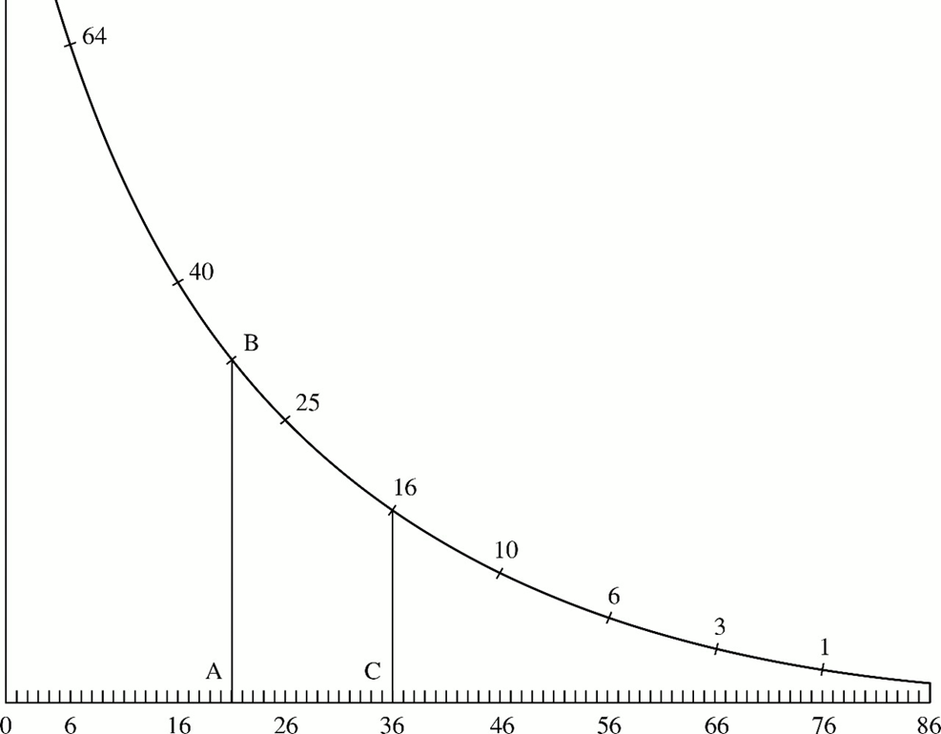

Survival analysis, circa 1669
Survival plot showing how many people out of 100 survived until 86 years of age, created by Christiaan Huygens (Dutch physicist, mathematician and astronomer) during 1669
Wainer, H. Annual Review of Psychology. Vol. 52: 305-335.

Slide 4
Background
Simply put, ‘survival analysis’ is the analysis of longitudinal event data, specifically the time-to-event
Often, and historically, these analyses focussed on the survival, or time-to-death, of people
But, the same models apply to the time to injury, illness, admission, readmission, recovery, or any definable health or disease state, and even the time to failure of machines!

Slide 5
Background
Consider typical survival data, where individuals are followed over time as they move from one state (alive) to another (dead)
Typically we would model binary states (alive/dead) with logistic regression and continuous variables (time) with ordinary linear regression
But neither model is appropriate when we have binary state change occurring over time, i.e., we care about both the state change and when it occurred (the ‘time-to-event’)

Slide 6
Background
As with other regression problems, we wish to
estimate (on average, how long did group A survive?)
compare (did group A survive longer than group B?)
model if a particular set of covariates predicts survival time
One new concept particularly relevant for survival analysis: censoring

Slide 7

Concepts: Censoring
Censoring: not all individuals will have the event of interest by the end of study (or, may be lost to follow-up or have a competing outcome)
Note that censored individuals still provide information for our analysis because they have some follow-up time without an event

Slide 8
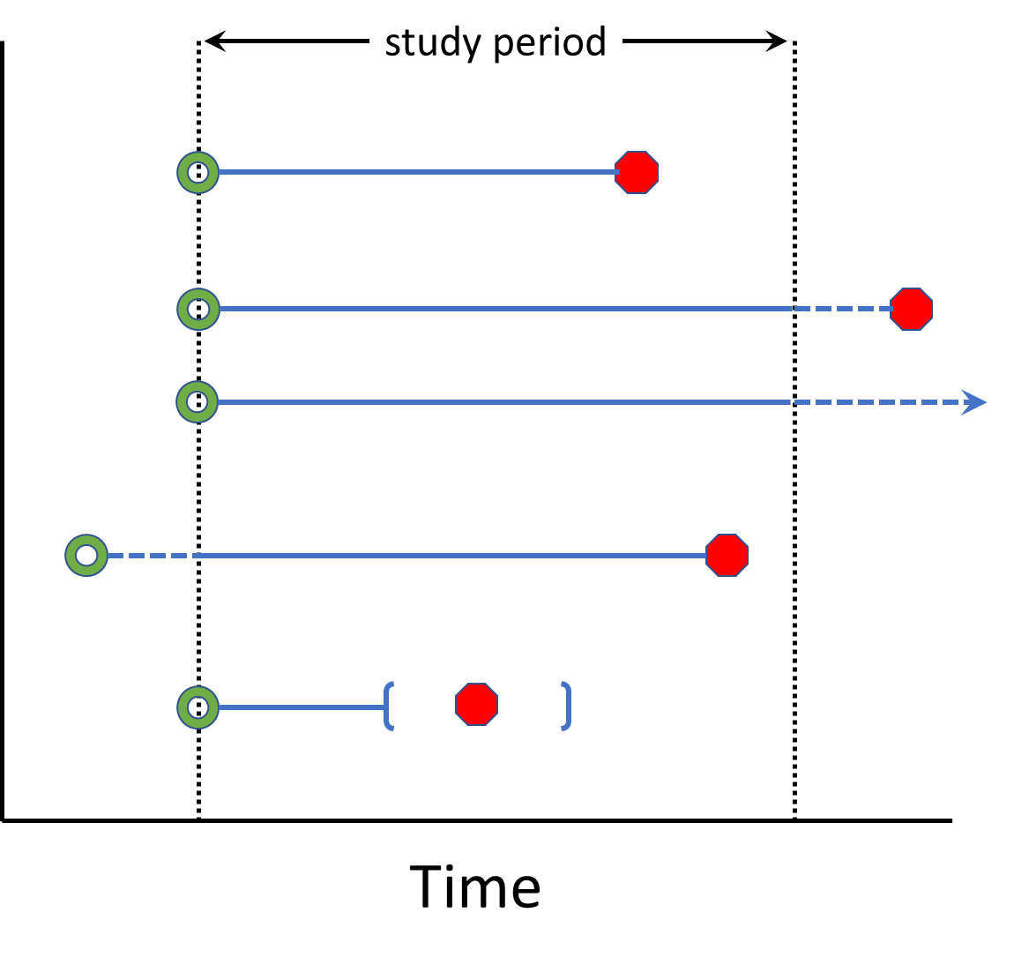
Concepts: Censoring
Right censoring: event occurs unknown time after end of follow-up
Left censoring: event occurs unknown time before start of follow-up
Interval censoring: event occurs at unknown time within a study interval

Slide 9

Survival analysis
Define event, time zero, time scale and exit
Event of interest: typically a single, clear-cut event (e.g., death, diagnosis, re-admission) but could be repeated (recurrent) events or multiple different (competing) events
Time zero (origin): beginning of follow-up, e.g., a fixed point in calendar time, a baseline age, a time of exposure or diagnosis, etc.
Time scale: usually calendar time, but could be age
How participants exit study: typically, when they have the event of interest or are censored (end of study, or lost to follow-up)

Slide 10
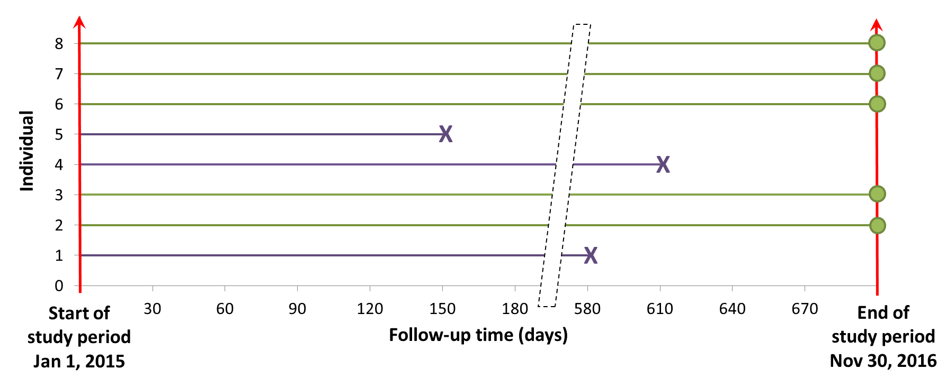
Example – analysis design
Event of interest: death due to drug overdose
Time zero: Jan 1, 2015
Time scale: calendar time in days
Exit: end of study (Nov 30, 2016) or overdose death
X Overdose death
Censored

Slide 11
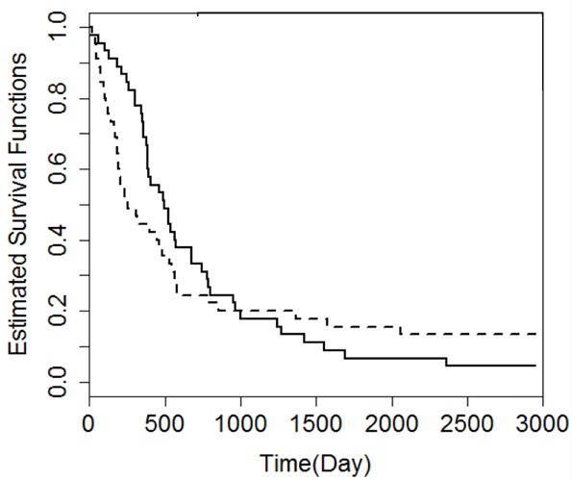
Survival analysis
Descriptive analysis: univariate modeling
non-parametric Kaplan-Meier curves describe survival distribution; provide proper median & quartile statistics
provide simple univariate comparisons between groups
statistical tests (e.g., log rank, Wilcoxon) can be used to compare curves but must be interpreted cautiously
Are these
different?

Slide 12
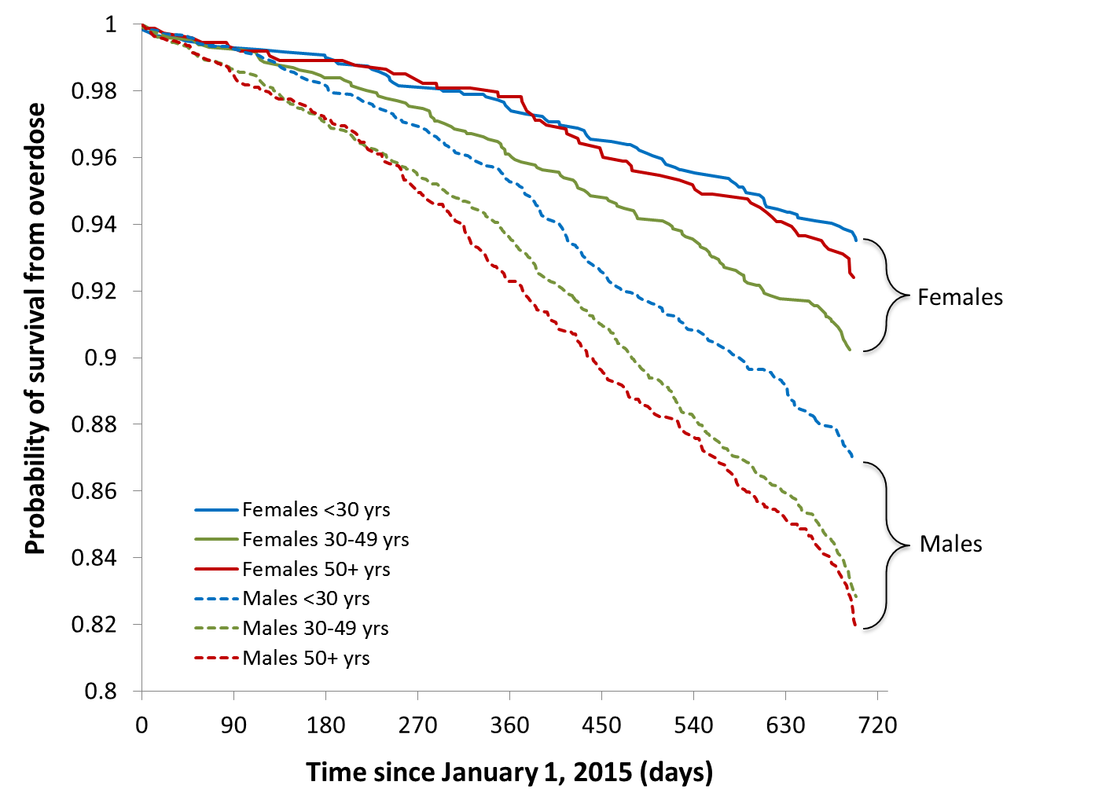
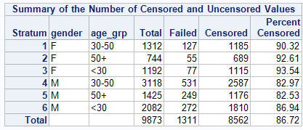
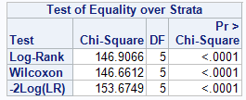
Example – KM curves

Slide 13
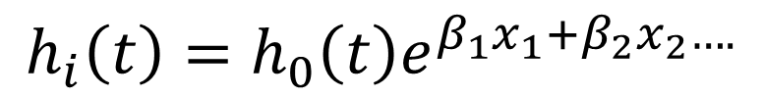
Survival analysis
Inferential analysis: multivariate modeling
Cox regression (semi-parametric)
Wait, we need some more concepts first…
$$h_{i}\left(t\right)=h_{0}\left(t\right)e^{β_{1}x_{1}+β_{2}x_{2}….}$$

Slide 14
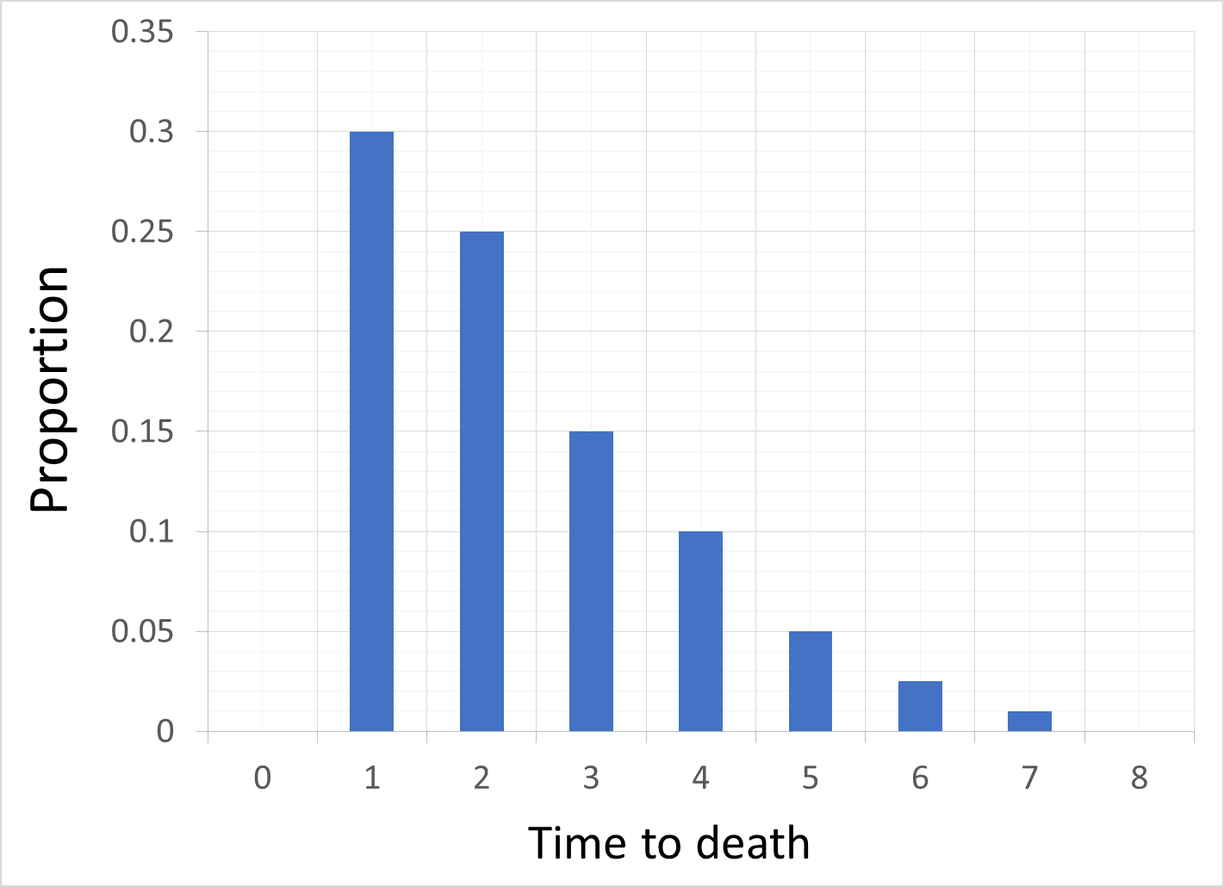
Concepts: Survival and hazard
30% died at time 1,
25% died at time 2…
etc.

Slide 15
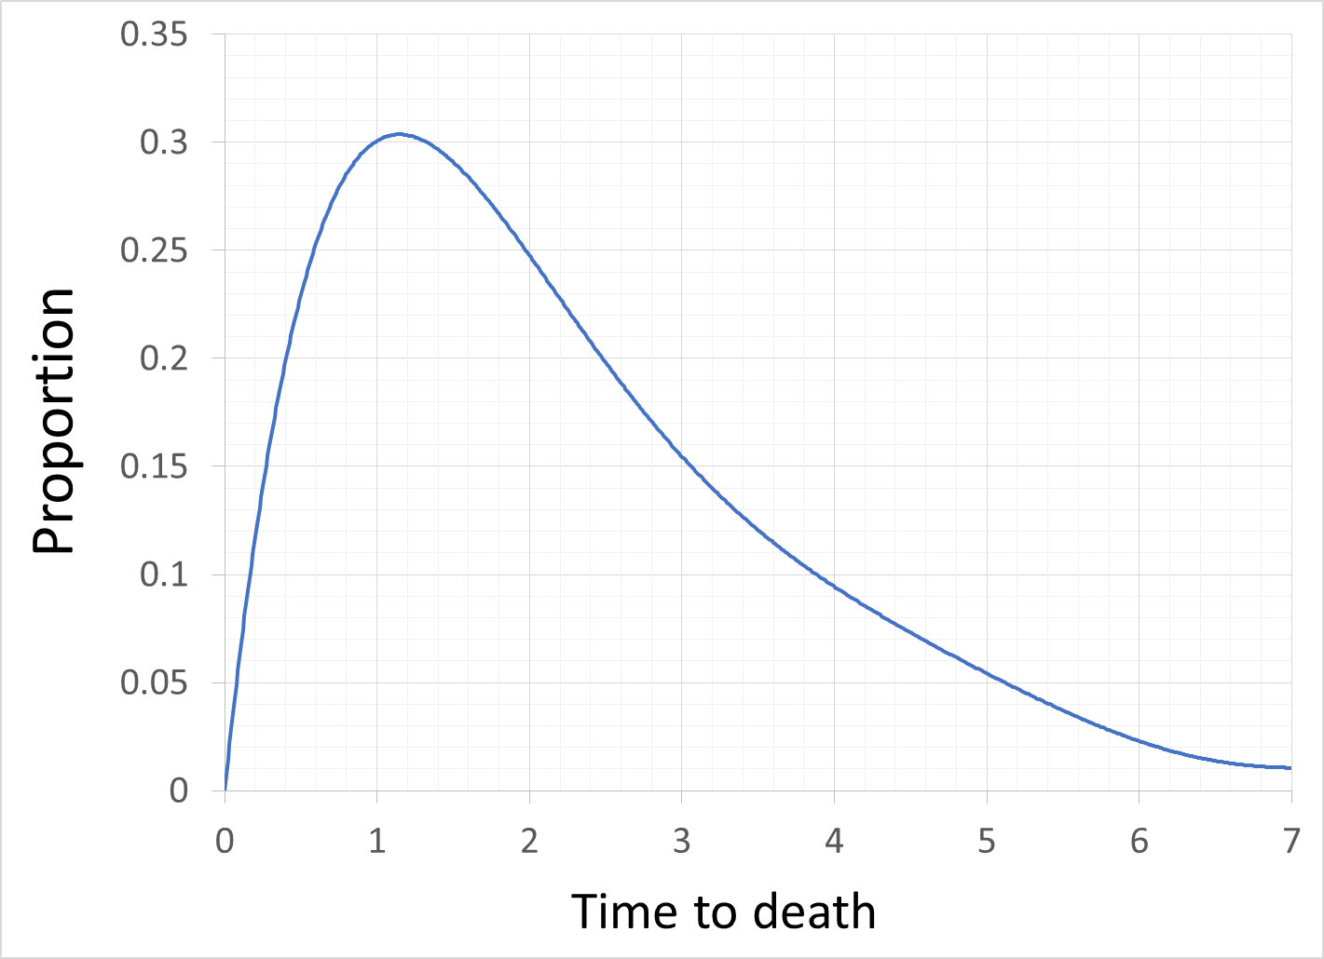
Concepts: Survival and hazard

Slide 16
Concepts: Survival and hazard
survival distribution, f(t)
Fraction dying
by time t, F(t)
Fraction surviving
by time t, S(t)

Slide 17
Concepts: Survival and hazard
f(t): distribution (probability density) of survival times
F(t): proportion of population dying by time t (cumulative distribution of f(t))
Survival function 1 – F(t) or S(t): proportion of population surviving by time t
Hazard function h(t): instantaneous risk of death at time t (or, probability of death in the next small interval)

Slide 18
Concepts: Survival and hazard
Often our interest is in modeling the hazard (e.g., risk of death), but what form should it take?
the simplest would be to assume a constant hazard (i.e., risk of death remains the same over time)
What would survival times look like if we have a constant hazard?

Slide 19
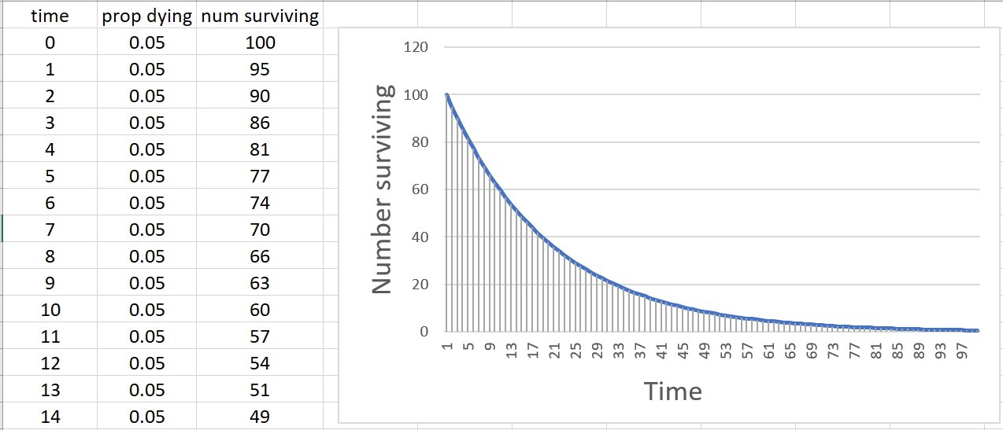

Constant hazard
Distribution of survival times
(constant hazard = 5%)
$$f\left(t\right)= λ0e^{−λt}$$
Assuming a constant hazard results in an exponential distribution of survival times

Slide 20
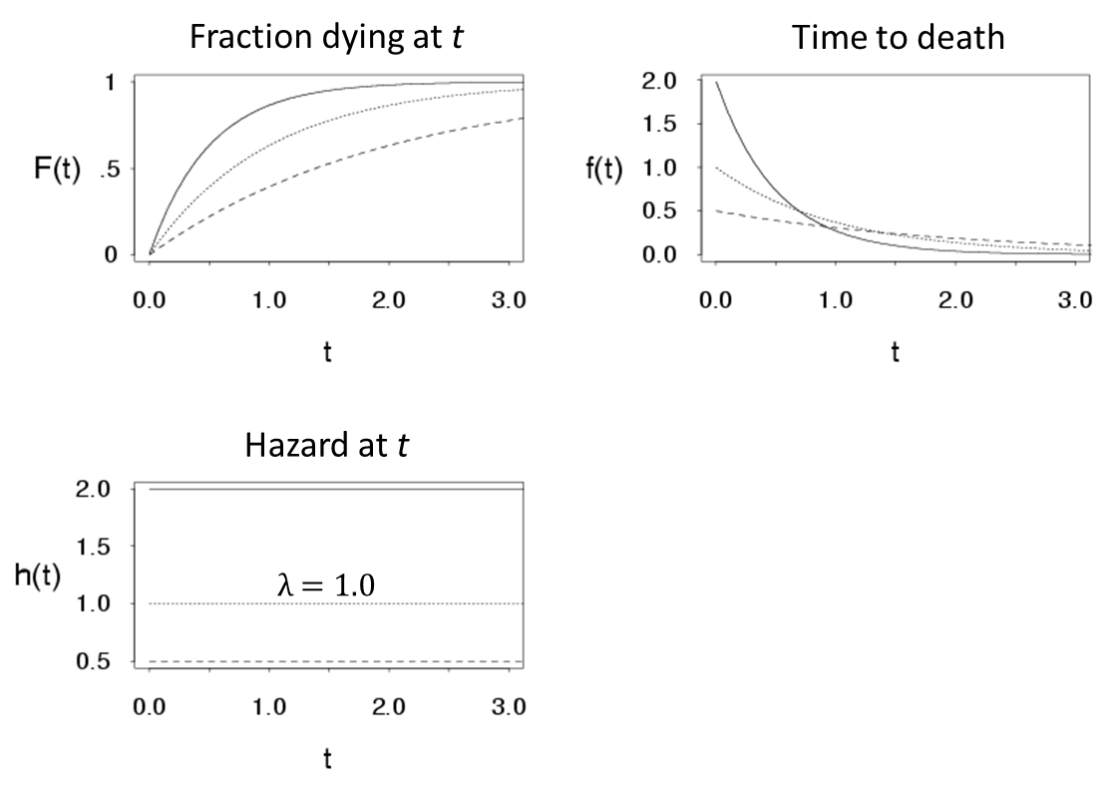
Constant hazard

Slide 21
Next time…
Regression models for survival data

Slide 22
References
Columbia University Mailman School of Public Health. Population Health Methods. Time to event data analysis. https://www.mailman.columbia.edu/research/population-health-methods/time-event-data-analysis
George H. Dunteman & Moon-Ho R. Ho. 2011. Survival Analysis. In, An Introduction to Generalized Linear Models. SAGE Publications, Inc.
McCullagh P, Nelder JA. 1989. Generalized Linear Models. Chapman & Hall.
O'Quigley, J., 2008. Proportional hazards regression (Vol. 542). New York: Springer.
Sainani, K.L. Introduction to Survival Analysis. Stanford University Department of Health Research and Policy. https://web.stanford.edu/~kcobb/index.html

